Slide 1
Online Banking Presentation
Chad Waltenburg
Trinity Fischer
Harrison Dubitz

Slide 2
Overview
Web application Type
MFA Factors
Other security considerations
Online Banking System
Passwords
OTP (Microsoft Authenticator)
Biometric
Password Strength
Same-site Secure Cookies
HTTPS
Account Lockout
JWT

Slide 3



Phishing/MITM prevention
Notification Emails
Domain Scanning
Mobile and Desktop App (All OSs)
Source: Panda Security

Slide 4
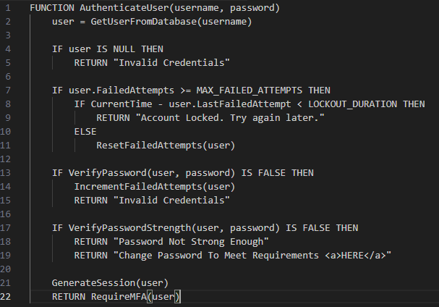
Example password function
Handles User Validation
Handles Password Validation
Tracks Failed Attempts
Increments Lockout Duration
Verifies Password Strength

Slide 5
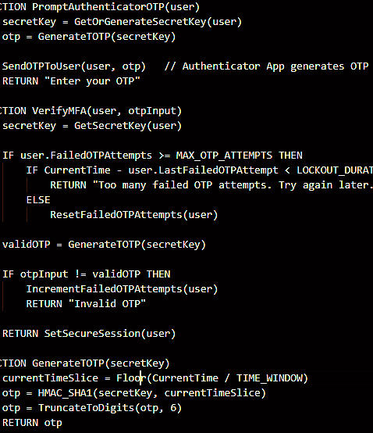
MFA: Timed One Time key
Uses Authenticator App (Microsoft)
Timed Window for the key
Sets a max OTP attempt limit before “account lockout”
Validates the TOTP

Slide 6
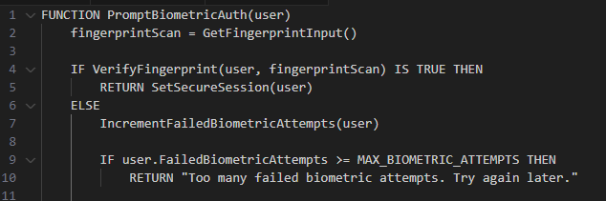
Biometric Authentication
Last MFA requirement
Tracks Failed Attempts

Slide 7
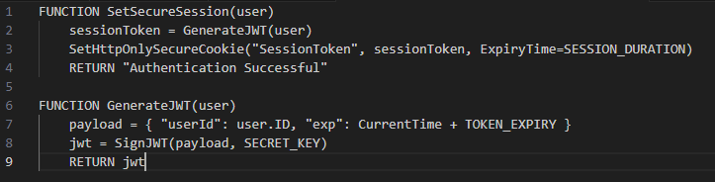
JWT and secure session
Secure tokens have limited duration.
Ends once the user logs out.
Utilized when important actions will be made.

Slide 8
Closing remarks and workflow diagram
https://mymstc-my.sharepoint.com/:u:/g/personal/17272722_mstc_edu/EevYiYqpkqlOuMjLV8mgX9kBMyHvgZhmDKTZR2smBm9V2w?e=Ter3Jk
Defense in Depth
Zero Trust Framework

